Slide 1


Slide 2
Barchart.com
Barchart.com
To download the financial data

Slide 3
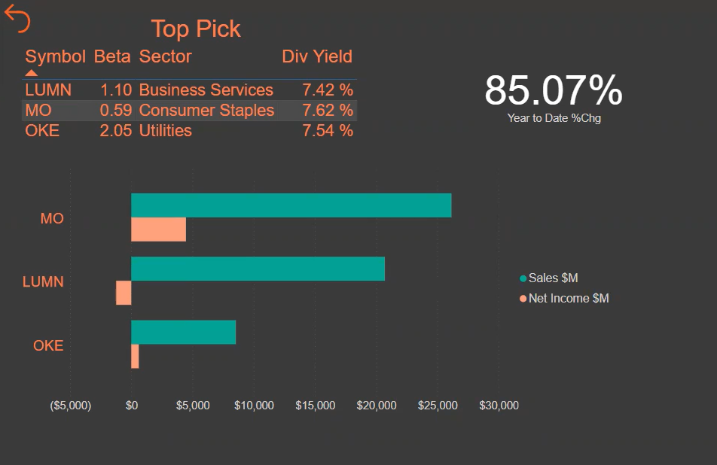
Relative Performance (for your HW)

Slide 4
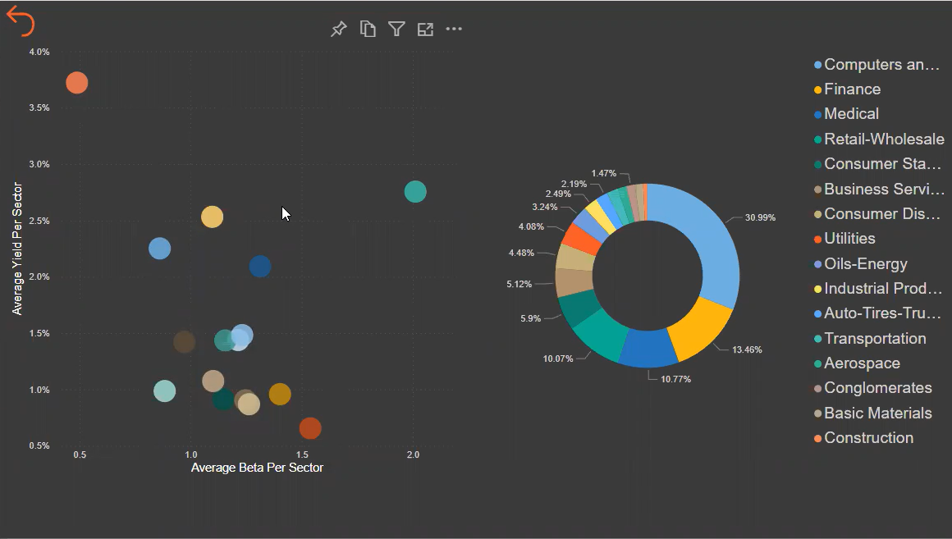
Sector Overview (for your HW)

Slide 5
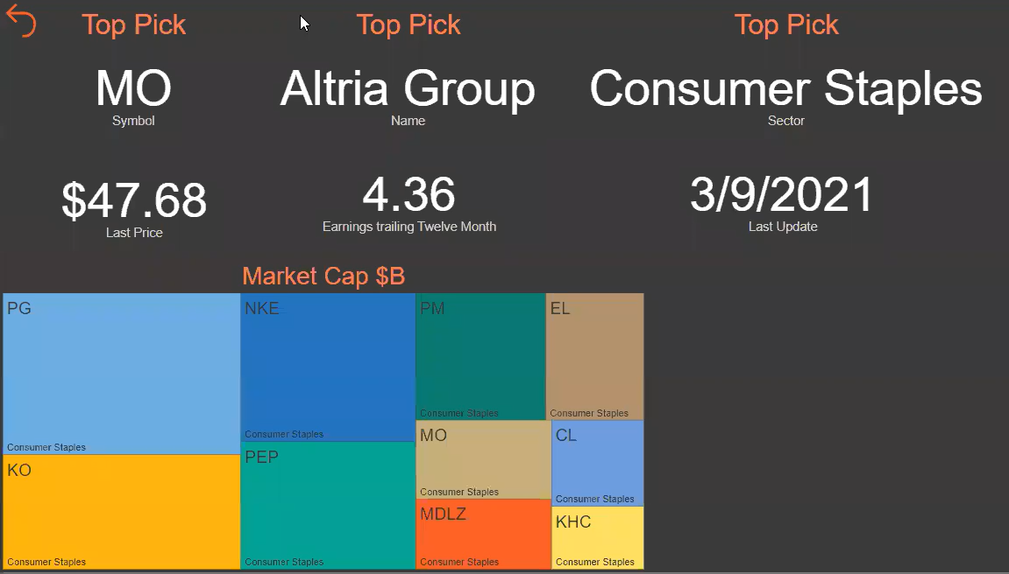
Top 3 Picks (for your HW)

Slide 6
Data Sets …
www.Data.gov
www.Kaggle.com
https://www.ahdatalytics.com/about-us/

Slide 7
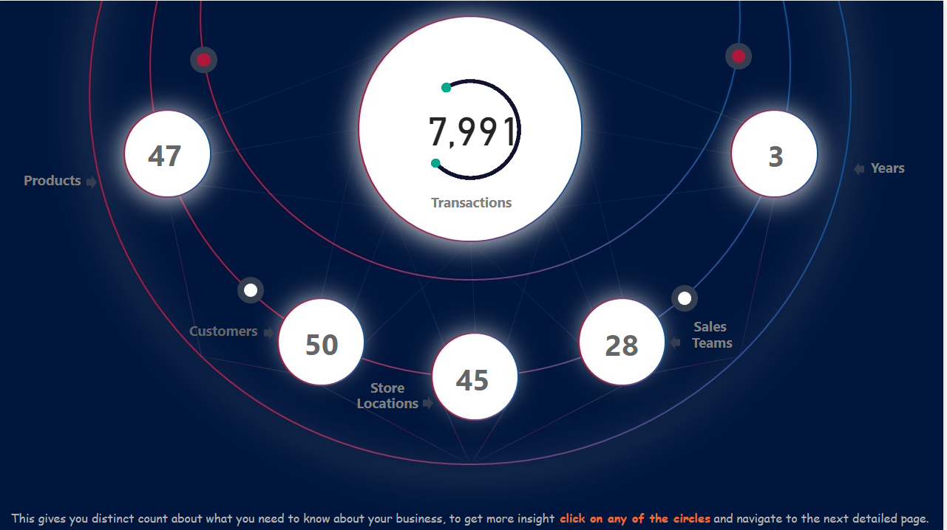
Ideas

Slide 8
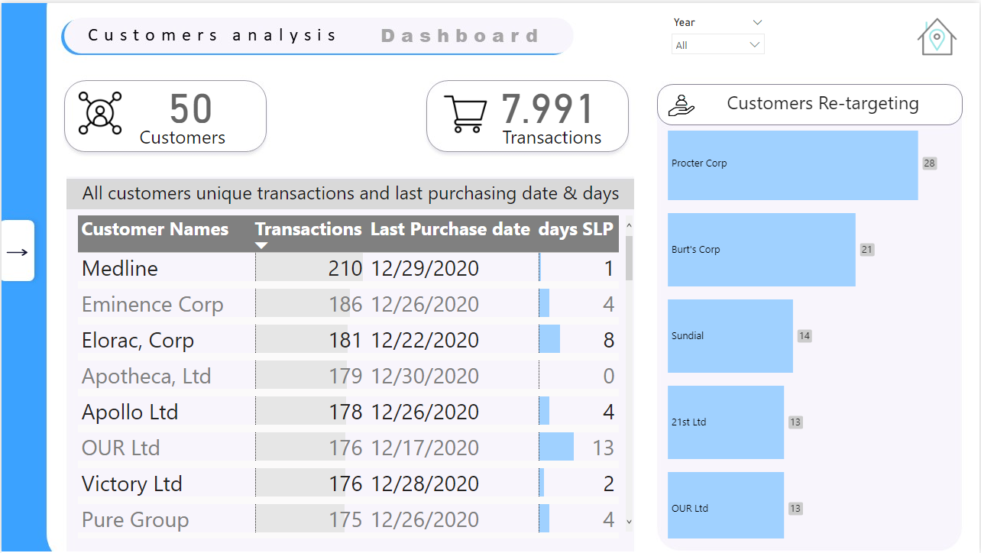
Dashboards …

Slide 9
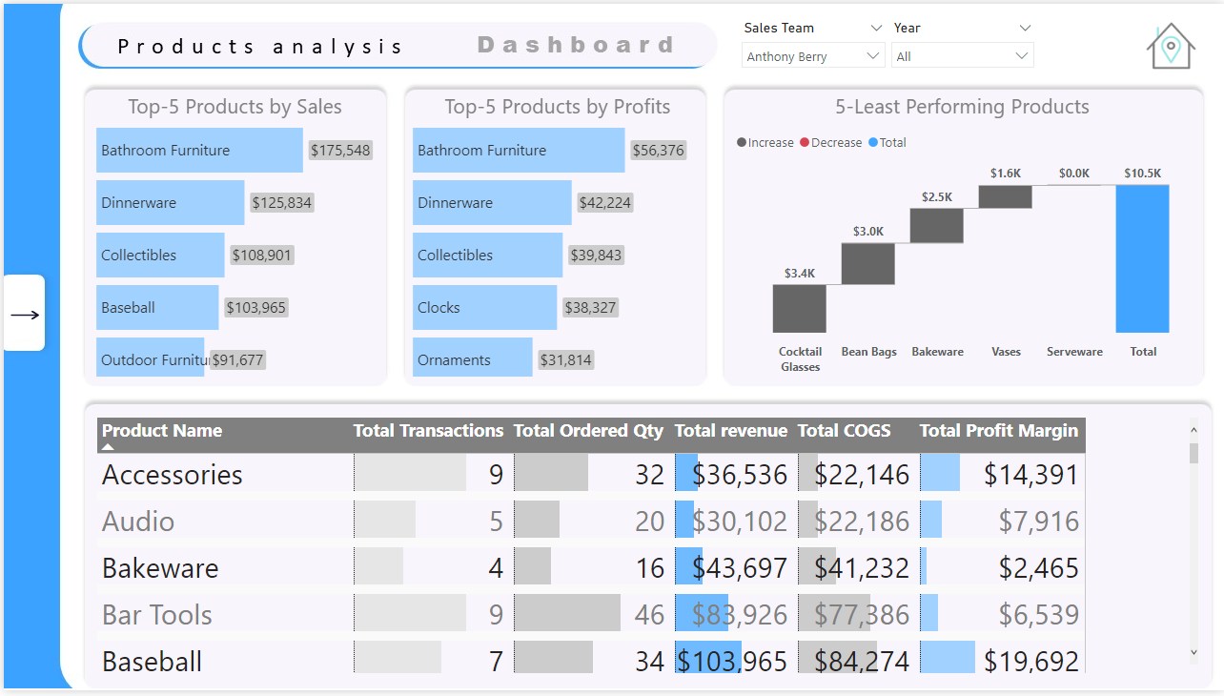
Dashboards …

Slide 10
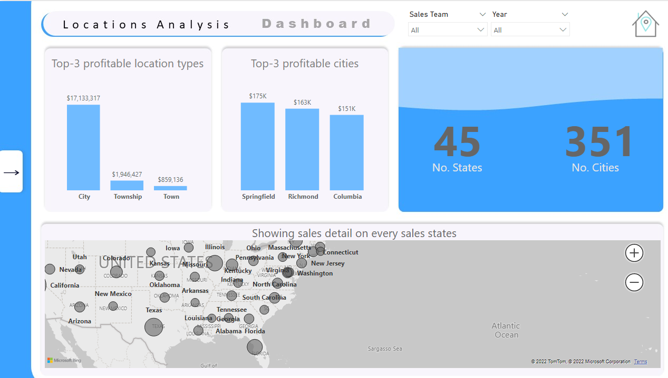
Dashboards …

Slide 11
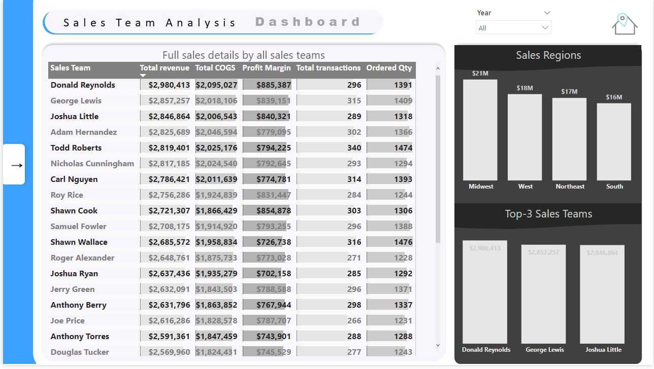
Dashboard …

Slide 12
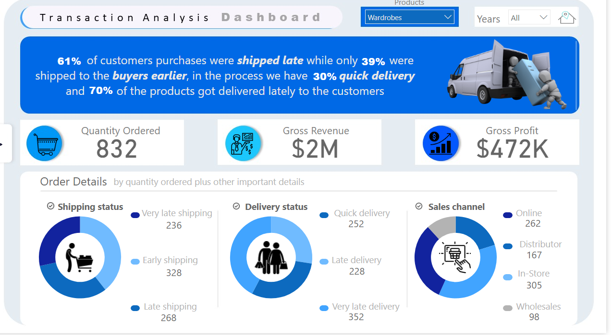
Dashboards …

Slide 13
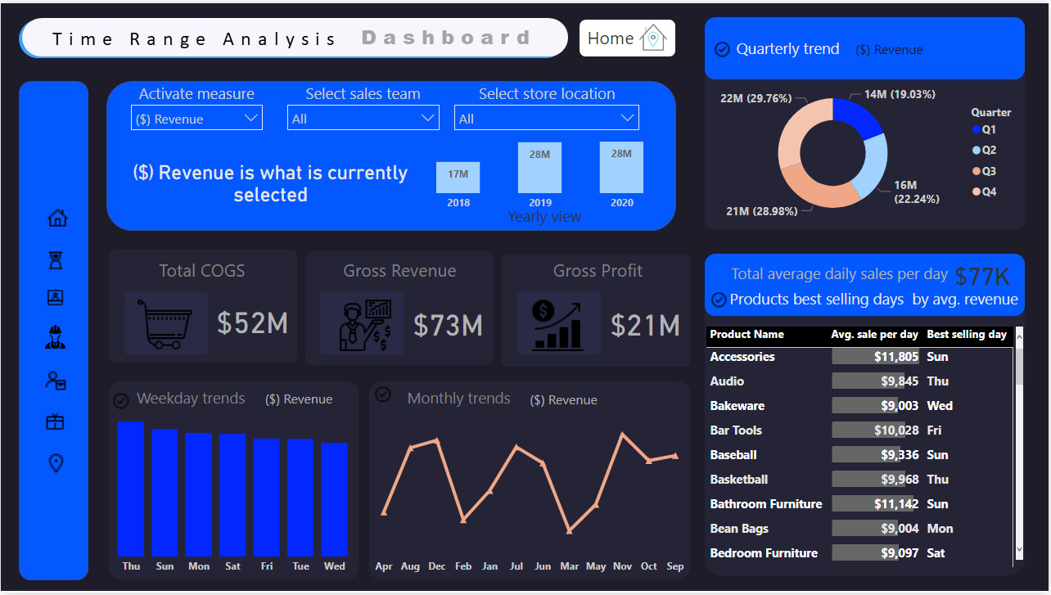
Dashboard …

Slide 14
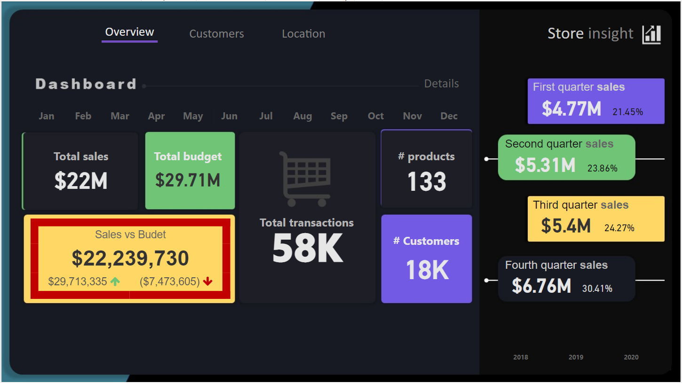
Dashboard …

Slide 15
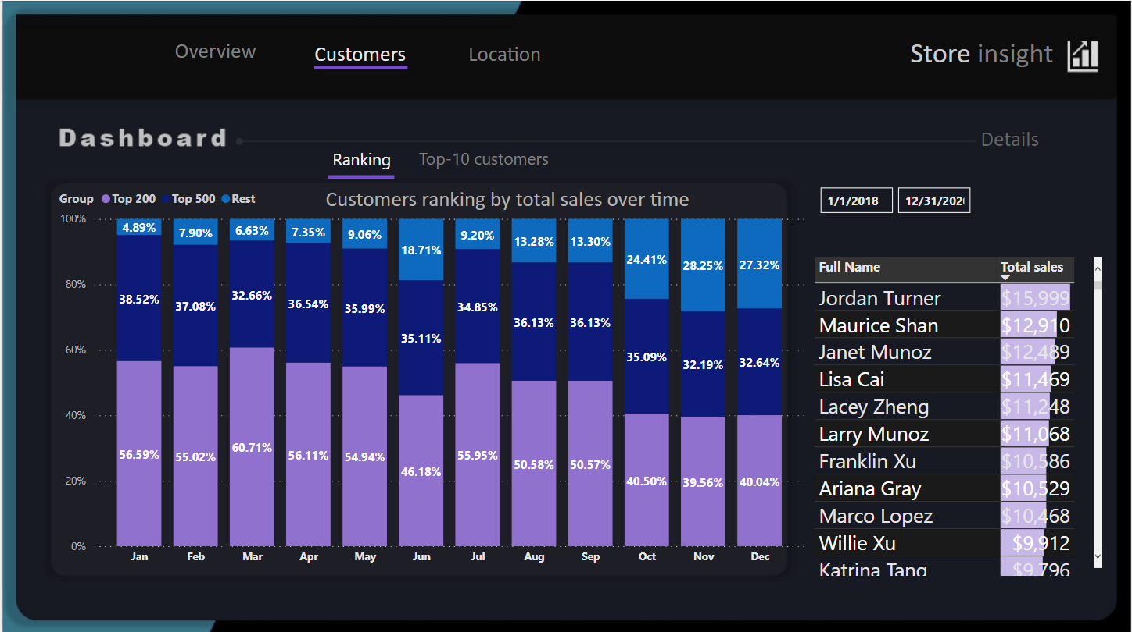
Dashboard

Slide 16
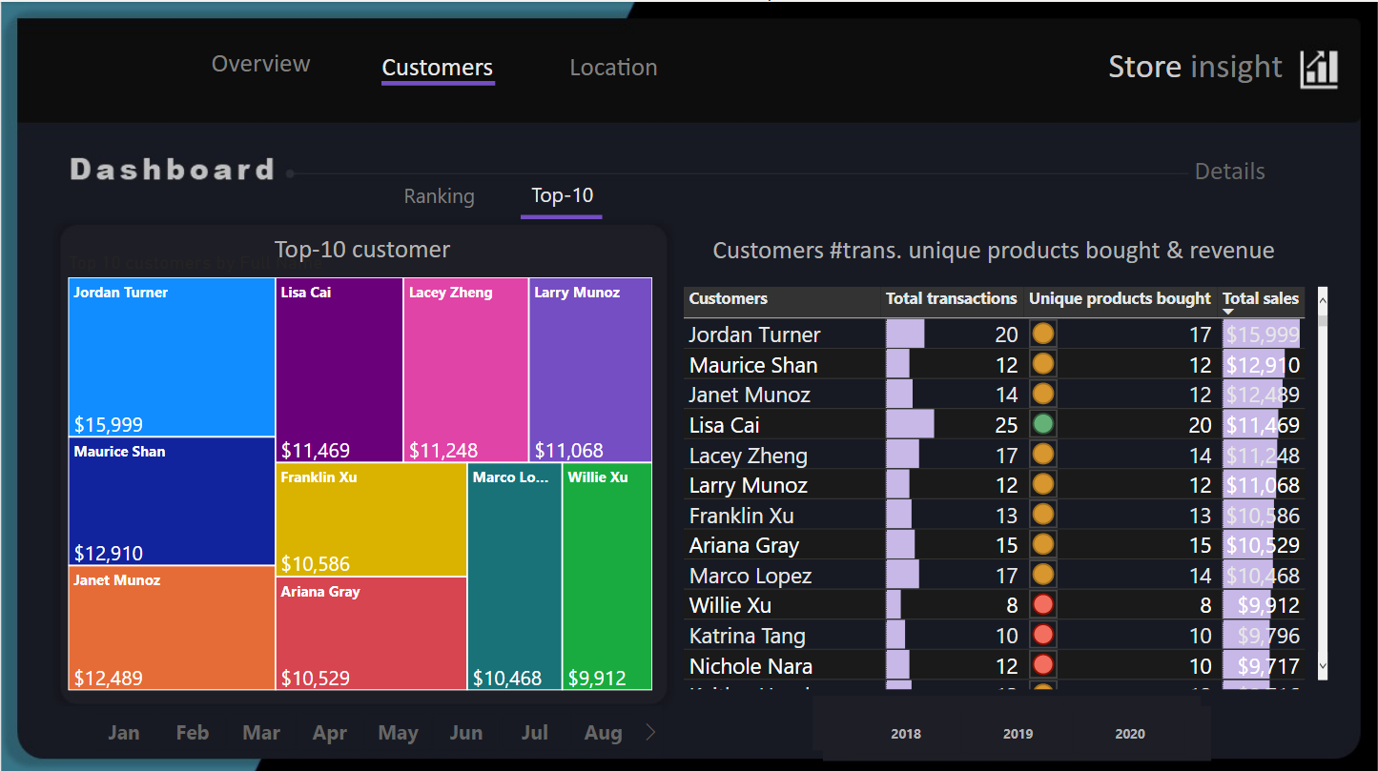
Dashboard

Slide 17
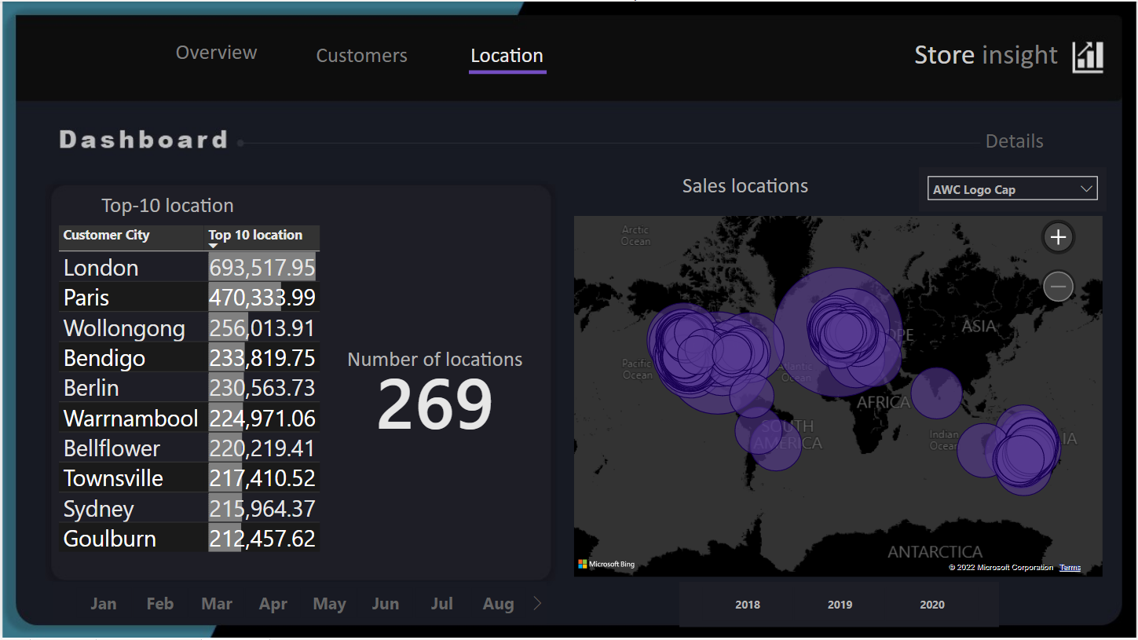
Dashboard

Slide 18
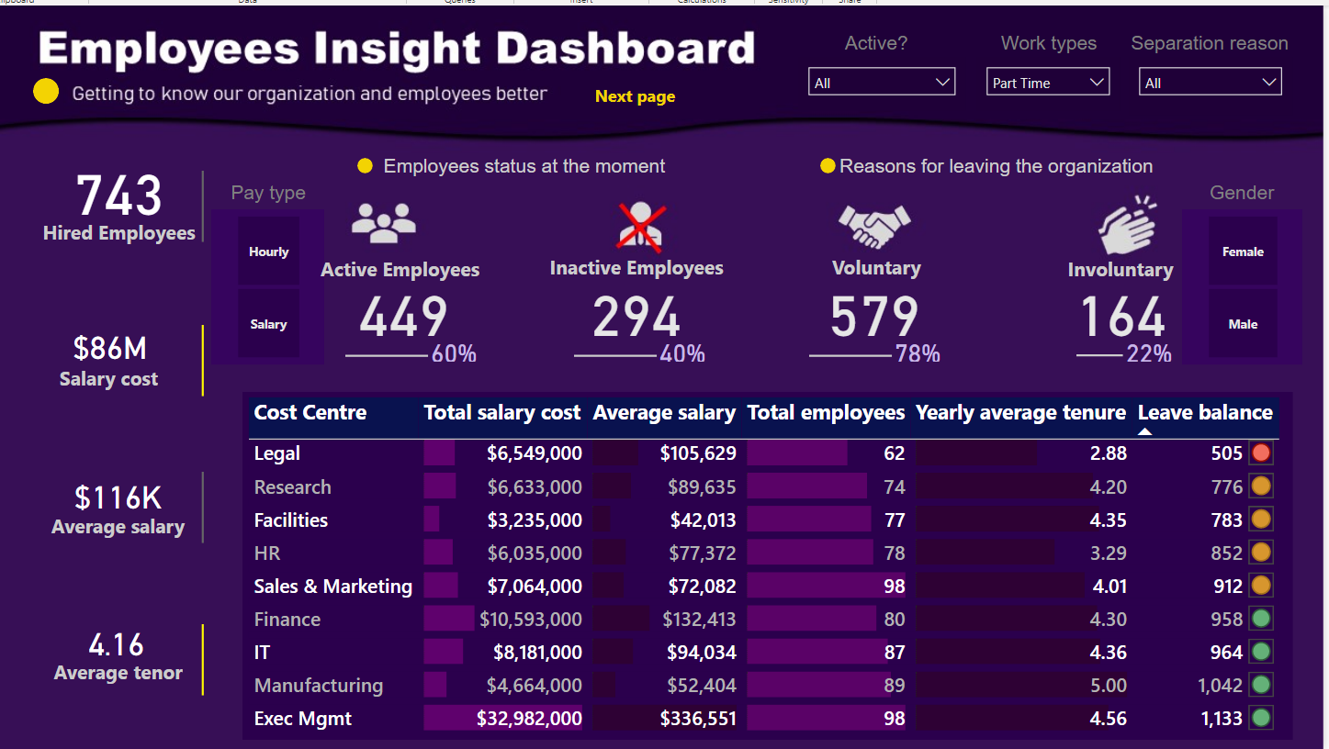
HR Dashboard

Slide 19
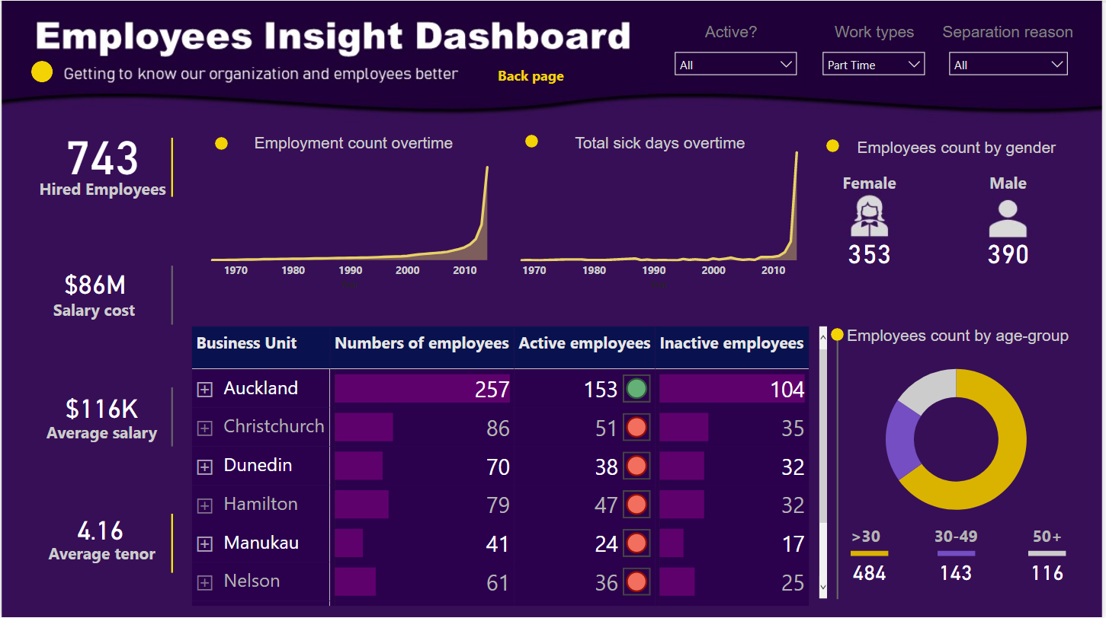
HR Dashboard

Slide 20
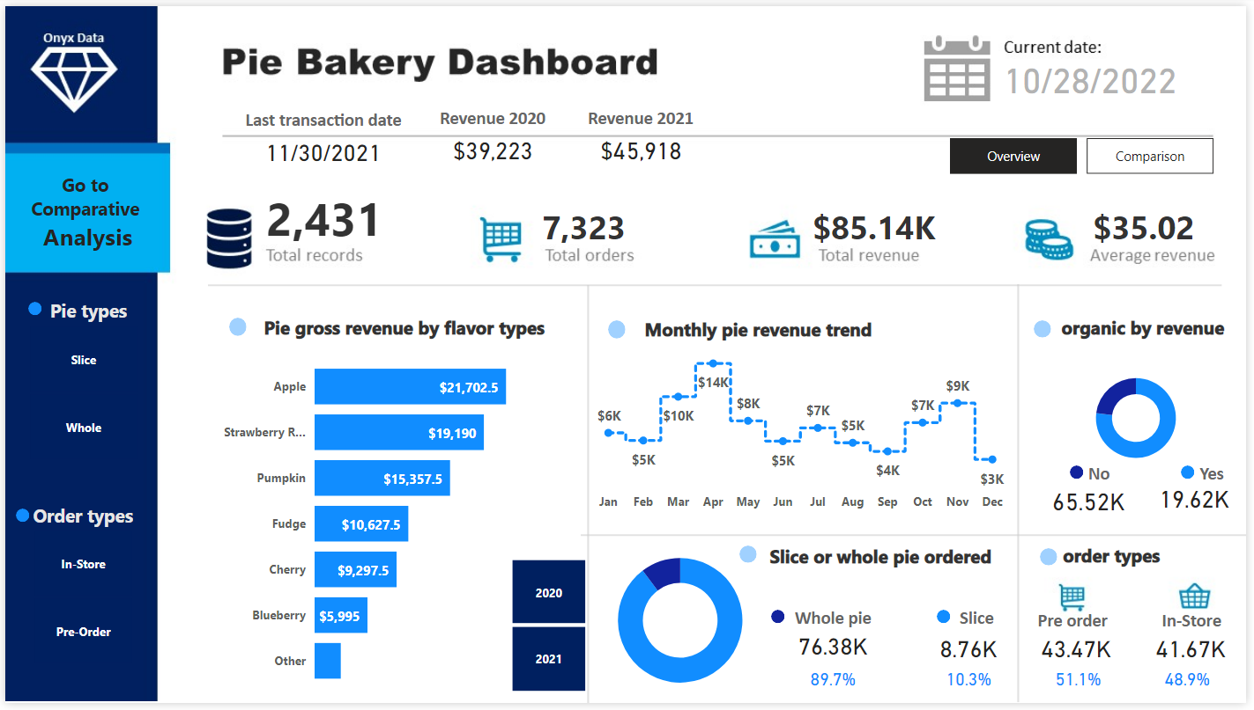

Slide 21
